Slide 1
OcuLearn
Experience the future of Learning

Slide 2
TEAM MEMBERS
Suyash Agarwal
Arnav Kalia
Muskan
Vatsal Chandra
P Ajay Venkatesh

Slide 3
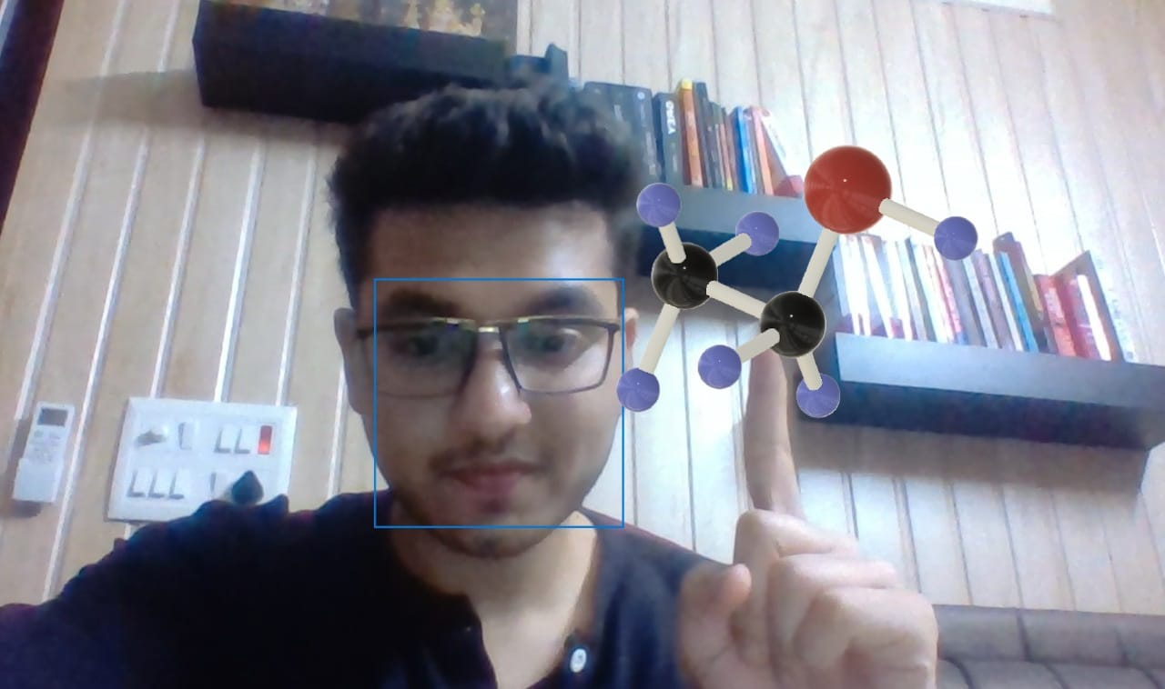
So what’s our
MOTIVATION??

Slide 4
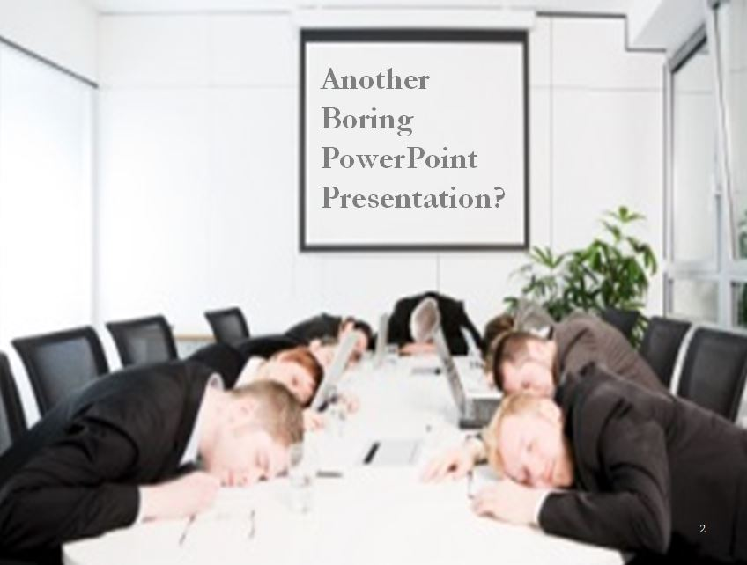
PROBLEM STATEMENT
In the pandemic world, we have shifted to the ONLINE mode and so have our lectures.
Although classes are becoming boring and simple presentations make us drowsy!
But what if those boring images and texts be given LIFE!
What if they were brought to the real world!!

Slide 5
SOLUTION/ ABSTRACT
We aim to create OcuLearn, a futuristic learning and presentation tool, that allows your presentation to come into real time space for the viewers.
OcuLearn provides you with a platform to visualize and manipulate any objects in your presentation as 3D models in the real-time space using gestures which will help the students to easily understand different aspects of a concept.
Now the speaker can bring in the 3D figures on live camera and engage students with a much more captivating presentation so that education doesn't have to compromise due to coronovirus!

Slide 6
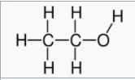
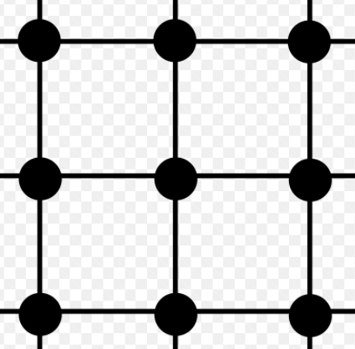
Structure of Ethanol
Ethanol (also called ethyl alcohol, grain alcohol, drinking alcohol, or simply alcohol) is an organic chemical compound. It is a simple alcohol with the chemical formula C2H6O.
Its formula can be also written as CH3−CH2−OH or C2H5OH (an ethyl group linked to a hydroxyl group), and is often abbreviated as EtOH. Ethanol is a volatile, flammable, colorless liquid with a slight characteristic odor. It is a psychoactive substance, recreational drug, and the active ingredient in alcoholic drinks

Slide 7
How does it work?
We have hosted a website which contains many premade 3D objects which a presenter can add them to their own presentations according to their topic relevance so as to make it more enhancing.
Anyone from around the world can make contributions to it so that there is whole library of 3D objects to choose from

Slide 8

METHODOLOGY
TECH STACK
OcuLearn provides you with a platform to visualize and manipulate any objects in your presentation as 3D models in the real-time space using gestures which will help the students to easily understand different aspects of a concept.
We have created some 3D models that explain concepts in different subjects and these models will be projected onto the presentation.
The 3D models can be easily controlled by panning, zooming and rotating.
PyOpenGL
PyGame
Blender
Fusion 360

Slide 9
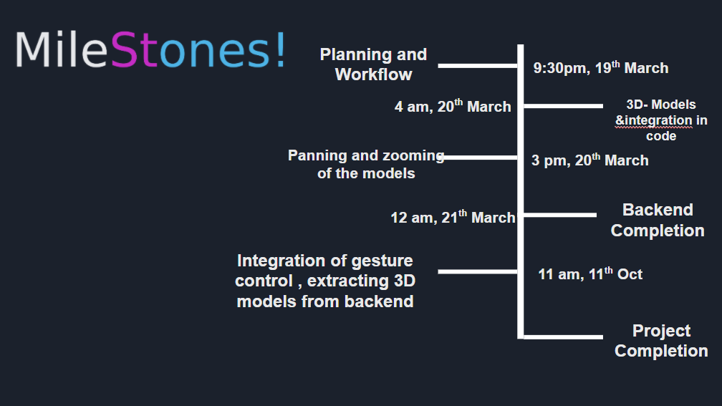

Slide 10

Since our main aim of this project is to make learning more interactive and interesting, in the near future we plan on implementing this in a VR so the student can actually experience what’s happening in front of their eyes
Secondly, a NLP model such that any Image/ object can be brought to life just by telling it!

Slide 11
Challenges Faced
Texture rendering
Intergration of the models in AR
Implementing of the 3D model in the presentation
Working of gesture recognition for panning and zooming of the 3D model

Slide 12
OUR README!
Here is our README link :
Let us see what it says!!
https://github.com/suagar10/OcuLearn/blob/master/README.md

